Slide 1


Sentiment Analysis of IMDb Movie Reviews
Carlos Escamilla
Tyler Heflin
Andres Melendez
Delilah Slabaugh
14 July 2025
Notes:
Hello, and welcome to our presentation on Sentiment Analysis of IMDb Movie Reviews. My name is Andres Melendez, and I’m presenting this on behalf of my teammates Carlos Escamilla, Tyler Heflin, and Delilah Slabaugh. Today, we'll walk you through how we used machine learning and NLP techniques to analyze the sentiment behind user-submitted movie reviews on IMDb.

Slide 2
Business Problem / Hypothesis
Determine whether IMDb movie reviews express positive or negative sentiments using NLP and ML.
Hypothesis: Classification accuracy can exceed 85% using classical ML techniques.
Notes:
The main business problem we tackled was determining whether user-submitted IMDb reviews were positive or negative using machine learning. In an era where user-generated content drives much online conversation, the ability to interpret audience sentiment is invaluable. Our central hypothesis was straightforward yet ambitious: if we correctly cleaned and processed the text, we could achieve classification accuracy above 85%. Proving this hypothesis demonstrates practical value in supporting recommendation engines, guiding content strategy, and informing market research.

Slide 3

Methodology
1. Data Cleaning: Removed HTML tags, stopwords, lowercased text.
2. Feature Engineering: TF-IDF applied; sentiment encoded (pos=1, neg=0).
3. Models Used: Logistic Regression, Random Forest, DistilBERT (Transformer-based).
4. Evaluation: Accuracy, Precision, Recall, F1-score.
5. Visualization: Word Clouds, ROC Curves, Confusion Matrices.
Notes:
On this slide, we break down the five main steps of our methodology in detail:
1. Data Cleaning: We started by removing unnecessary elements from the text, such as HTML tags and stopwords, and converting all text to lowercase. This step ensures consistency and reduces noise so the model focuses on meaningful words.
2. Feature Engineering: Next, we used TF‑IDF to convert our text into numerical vectors. This method assigns weights to words based on their unique and informative characteristics, which helps the model identify patterns more effectively. We also encoded our target variable so positive reviews were labeled as one and negative reviews as 0.
3. Models Used: We trained three different models: Logistic Regression, Random Forest, and DistilBERT, a transformer-based model known for understanding context in language. This allowed us to compare traditional machine learning approaches with state-of-the-art deep learning techniques.
4. Evaluation: We didn’t rely solely on accuracy. We also tracked precision, recall, and F1‑score. These metrics help us understand how often the model is correct and how well it balances false positives and negatives.
5. Visualization: Finally, we visualized results with word clouds, ROC curves, and confusion matrices. These visuals helped us interpret the performance and understand where each model excelled or struggled.
Altogether, these steps formed a workflow that could be reused on similar datasets for other businesses or projects.

Slide 4
IMDb Dataset Overview
50,000 labeled movie reviews from Kaggle
Balanced dataset: 25,000 positive, 25,000 negative
Reviews are pre-divided into training and test sets
Average review length: ~230 words
Challenges: sarcasm, ambiguous phrasing, class overlap
Notes:
On this slide, we dive into the dataset itself. We worked with 50,000 labeled movie reviews from Kaggle, evenly split between positive and negative. The average review length was 230 words, giving us a rich data set. The challenge we encountered was sarcasm and ambiguous phrasing—these subtleties make it harder for models to classify reviews correctly.

Slide 5
Modeling Strategy & Tuning
Used train/test split (80/20)
GridSearchCV for hyperparameter tuning
Avoided overfitting via cross-validation
DistilBERT used HuggingFace Transformers
Model training: Logistic Regression (1 min), DistilBERT (~20 mins w/GPU)
Notes:
Slide 5 - Modeling Strategy & Tuning
On this slide, we dive into how we approached model development and tuning in more detail.
We started with a train/test split of 80/20. This ensured we had a large enough portion of the data for training while keeping a clean, untouched set for evaluation.
We used GridSearchCV for hyperparameter tuning. This process systematically tries different combinations of parameters. For example, with Logistic Regression, we tested different regularization strengths, while for Random Forest, we tuned the number of trees and maximum depth. This step was crucial to finding the most optimal setup for each model.
We also avoided overfitting through cross-validation. By validating on multiple folds of the training set, we could confirm that the model wasn’t just memorizing the data but was truly learning generalizable patterns.
For DistilBERT, we utilized HuggingFace Transformers. This gave us access to a pre-trained language model that understands context and semantics much better than traditional methods. We fine-tuned it on our IMDb dataset, significantly boosting performance compared to simpler models.
In terms of training time, Logistic Regression completed in under a minute due to its computational simplicity, while DistilBERT required about 20 minutes with GPU acceleration.
Altogether, these strategies allowed us to compare a traditional model, an ensemble method, and a transformer-based model on equal footing and to understand where each shines and where it truly falls short.

Slide 6
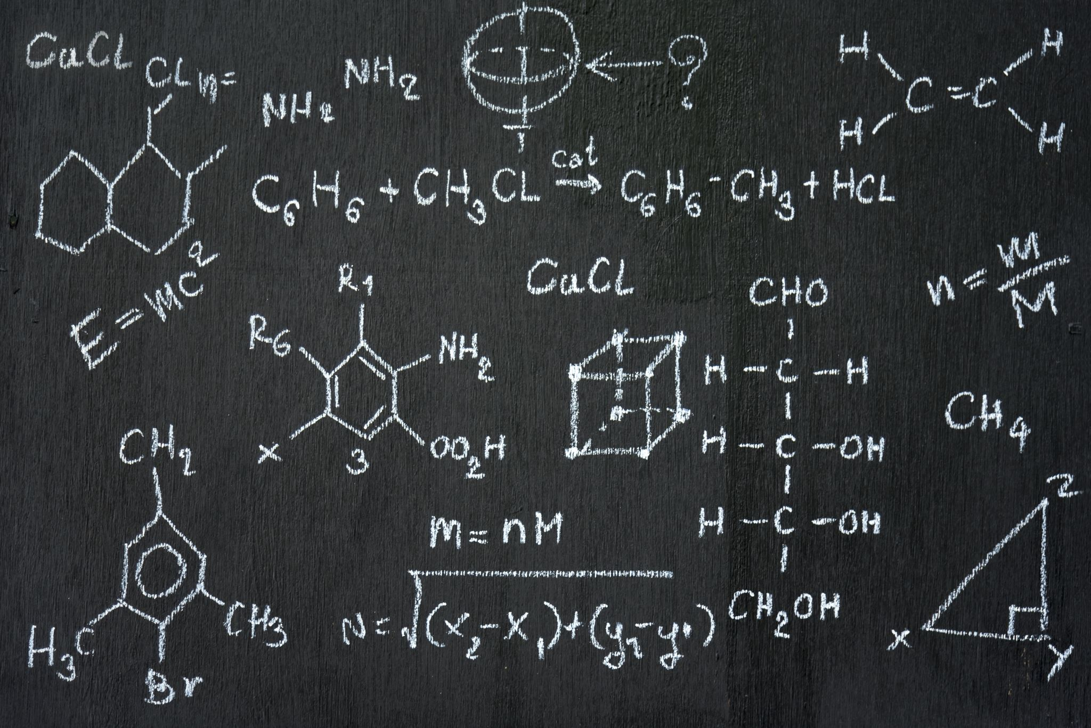
Results Summary
DistilBERT (Transformer-based): Accuracy = 91%
Logistic Regression: Accuracy = 88%, AUC = 0.96
Random Forest: Accuracy = 84%
→ DistilBERT outperformed other models overall. → Strong separation between classes demonstrated via ROC and Confusion Matrix.
Notes:
When we moved into the modeling phase, we noticed interesting patterns in the results. We tested Logistic Regression, Random Forest, and DistilBERT. DistilBERT outperformed the others with 91% accuracy, thanks to its transformer architecture that captures context and nuance. Logistic Regression was closely followed with 88% accuracy and an AUC of 0.96, proving a strong baseline. Random Forest achieved 84% accuracy, which, while respectable, was not as strong given the nature of text features. Our evaluation metrics and visualizations supported these findings, which confirmed each model’s strengths and weaknesses.

Slide 7

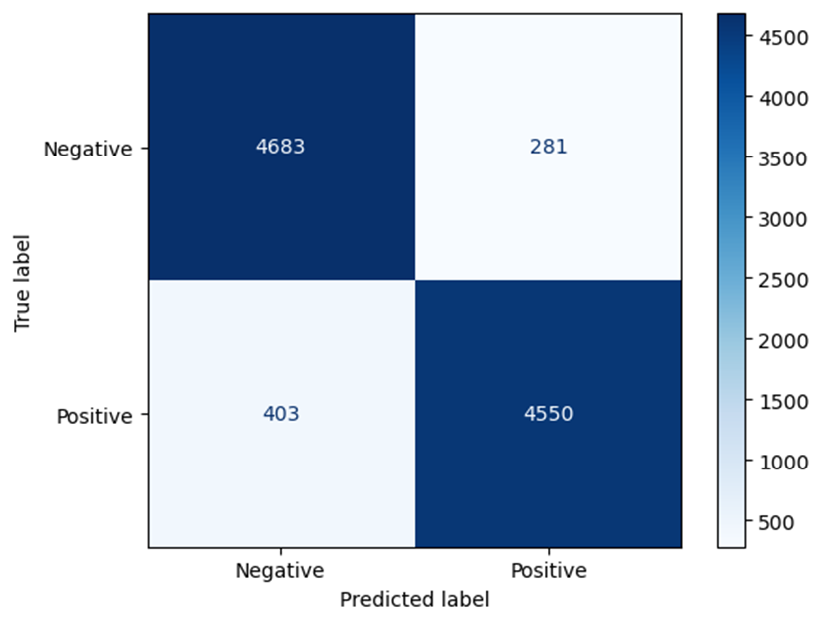
Confusion Matrix – DistilBERT
Notes:
Here, we present the confusion matrix for DistilBERT, our best-performing model. It shows an extreme separation between positive and negative reviews, with minimal misclassification. This visualization highlights why DistilBERT’s transformer-based approach excelled in capturing subtle sentiment cues.

Slide 8
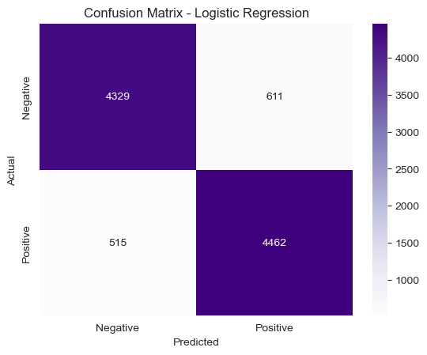
Confusion Matrix – Logistic Regression
Notes:
This slide shows the confusion matrix for Logistic Regression. Although slightly less accurate than DistilBERT, it still demonstrates a well-balanced performance with low false positives and false negatives. It’s an excellent baseline model for scenarios with limited computational resources.

Slide 9
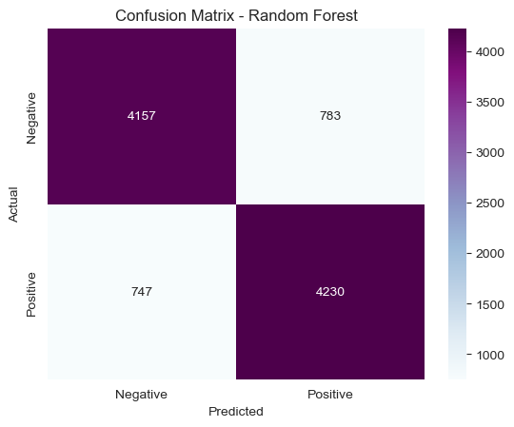
Confusion Matrix – Random Forest
Notes:
Here is the confusion matrix for the Random Forest model. While it correctly classified many reviews, the misclassification rates were higher than those of the other two models. This outcome reflects Random Forest’s limitations with high-dimensional, sparse text features compared to linear or transformer-based approaches.

Slide 10
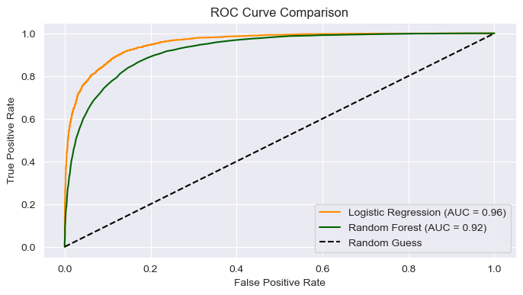
ROC Curve Comparison
Notes:
This slide shows a comparison of ROC curves across the models. The Logistic Regression models show curves that hug the top-left corner, indicating strong, accurate, favorable rates with minimal false positives. The Random Forest curve sits lower, showing its relatively weaker performance in this specific task.

Slide 11
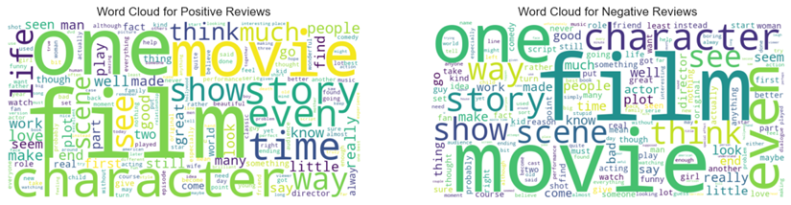
Word Clouds – Sentiment Words
Notes:
These word clouds illustrate the most frequent terms in positive and negative reviews. Positive reviews prominently feature words like 'great', 'love', and 'story', while negative reviews highlight terms like 'bad', 'worst', and 'boring'. These visualizations give us intuitive insight into how reviewers express sentiment.

Slide 12
Conclusion
✔ Hypothesis confirmed with 91% accuracy using DistilBERT.
✔ Classical ML + TF-IDF = effective and interpretable.
✔ Strong model generalization with room for deep learning extensions.
Notes:
As we wrap up, let’s reflect on what we achieved and learned through this project:
First, our hypothesis was confirmed. We set out to see if we could exceed 85% accuracy in sentiment classification, and we achieved 91% accuracy with DistilBERT, which shows the power of transformer-based models for understanding natural language.
Second, we demonstrated that classical machine learning combined with TF‑IDF is still highly effective and interpretable. Logistic Regression and TF‑IDF gave us strong results with minimal computational cost. This approach is still efficient for businesses that need quick, explainable models without heavy hardware requirements.
Third, our results show strong model generalization. Even though we trained on IMDb reviews, the workflow we developed could easily be extended to other platforms like Amazon product reviews, Yelp restaurant feedback, or even social media posts. And while our transformer model performed best, there’s room to push further—future work could include more advanced transformers, adding a neutral sentiment class, or even building a live dashboard for real-time analysis.
This project shows that combining careful data preparation, thoughtful model selection, and precise evaluation metrics can lead to powerful insights and practical solutions.

Slide 13
Q&A – Discussion Points
• Why was Logistic Regression more effective than Random Forest?
• How does TF-IDF compare to Word Embeddings?
• What are some ways to handle neutral sentiments?
• What ethical considerations exist in sentiment analysis?
Notes:
Here are some discussion questions we considered:
Why was Logistic Regression more effective than Random Forest? Logistic Regression works well when there is a clear linear separation in the data. In our case, TF‑IDF features created a space where positive and negative reviews were more easily separable, which gave Logistic Regression an edge.
How does TF‑IDF compare to Word Embeddings? TF‑IDF is a simpler representation, focusing on term frequency and importance in documents, but it does not capture context or semantics. Word embeddings, on the other hand, can capture richer relationships between words, but require more resources and careful tuning.
What are some ways to handle neutral sentiments? One way is to expand the dataset and label reviews as positive, negative, or neutral, and then train a multi‑class model. Another approach is to define thresholds so that reviews with mixed or unclear sentiment are classified as neutral.
What ethical considerations exist in sentiment analysis? We need to consider privacy of user data, potential bias in the training data, and ensuring that our model’s decisions do not unfairly impact certain groups or lead to unintended consequences in automated systems.

Slide 14
Applications of Sentiment Analysis
Streaming services: personalized recommendations
Brands: product feedback and customer satisfaction
Media platforms: detect toxic or biased content
Business intelligence: trend analysis from reviews
Notes:
Let’s look at some real-world applications of sentiment analysis and why this technology matters beyond our project:
Streaming services: Platforms like Netflix, Hulu, or Disney+ use sentiment analysis to dig into user reviews and social media chatter. By understanding which shows or movies get positive feedback, they can make better recommendations and decide what content to produce next.
Brands: Companies selling products or services use sentiment analysis on reviews from sites like Amazon or Google. If they see a trend of negative feedback about a specific feature or quality issue, they can address it quickly. Conversely, positive sentiment helps them identify what customers truly value.
Media platforms: Social networks and news outlets can monitor comments and posts for toxic language, hate speech, or biased content. Automated sentiment analysis can flag problematic content faster than manual moderation, helping keep communities safe and civil.
Business intelligence: Sentiment analysis gives organizations the ability to track trends over time. For example, if customer reviews start showing more positive language after a new product update, that’s evidence that the change is working. Similarly, sudden spikes in negative sentiment might indicate a problem that needs immediate attention.
Overall, sentiment analysis is a versatile tool that turns massive amounts of unstructured text into actionable insights across industries.

Slide 15
Future Improvements & Next Steps
Add a neutral class for 3-way classification
Explore more advanced transformer models (e.g., RoBERTa, BERTweet)
Perform domain-specific fine-tuning (e.g., movie vs. product reviews)
Deploy as a Streamlit dashboard or API for real-time use
Notes:
Looking forward, there are several opportunities to build on what we’ve done and take this project even further:
First, a neutral class is added for a‑way of classification. Right now, our model only distinguishes between positive and negative reviews. Introducing a neutral category would allow us to capture reviews that don’t lean either way. This could give businesses a more nuanced understanding of customer sentiment and highlight areas where opinions are mixed.
Second, exploring more advanced transformer models. DistilBERT performed exceptionally well, but newer models like RoBERTa or BERTweet have been optimized for specific use cases, such as social media data. Testing these models might reveal even better performance, especially for domain-specific language patterns.
Third, performing domain-specific fine-tuning. Our dataset was based on movies, but sentiment can vary by industry. For example, product reviews might emphasize quality and shipping speed, while restaurant reviews focus on service and taste. Fine-tuning models on specific domains would likely boost accuracy and relevance in those contexts.
Finally, deploying as a Streamlit dashboard or an API. This would make our model interactive and usable in real time. A dashboard could allow a business analyst to upload new review data and instantly see sentiment trends. At the same time, an API could integrate into existing workflows to provide automatic insights without additional manual steps.
These improvements would transform this project from a proof‑of‑concept into a powerful, production-ready sentiment analysis system.
Thank you for listening. We hope this analysis provides a strong example of practical sentiment classification.

